Slide 1
CSCI – 4135: Spring 2022
Web Application Engineering
Instructor: Sujoy Chakraborty
Slides – 24

Slide 2
Setting up the development environment

Slide 3
Outline
nodeJs
angular-cli
Visual studio code(VsCode)

Slide 4
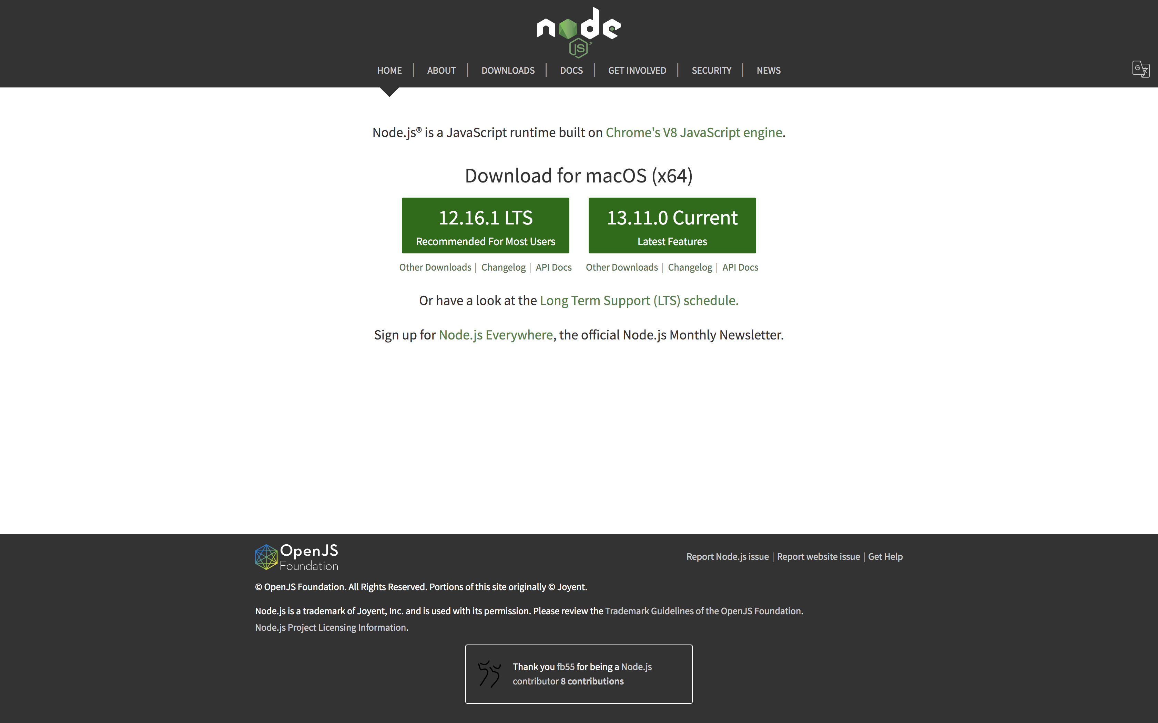
nojeJs
A runtime environment for executing JavaScript code outside the browser.
Provides some tools that we’d need to build angular projects.
Go to https://nodejs.org/en/
Download and install the version on the left, which is the latest stable version.

Slide 5
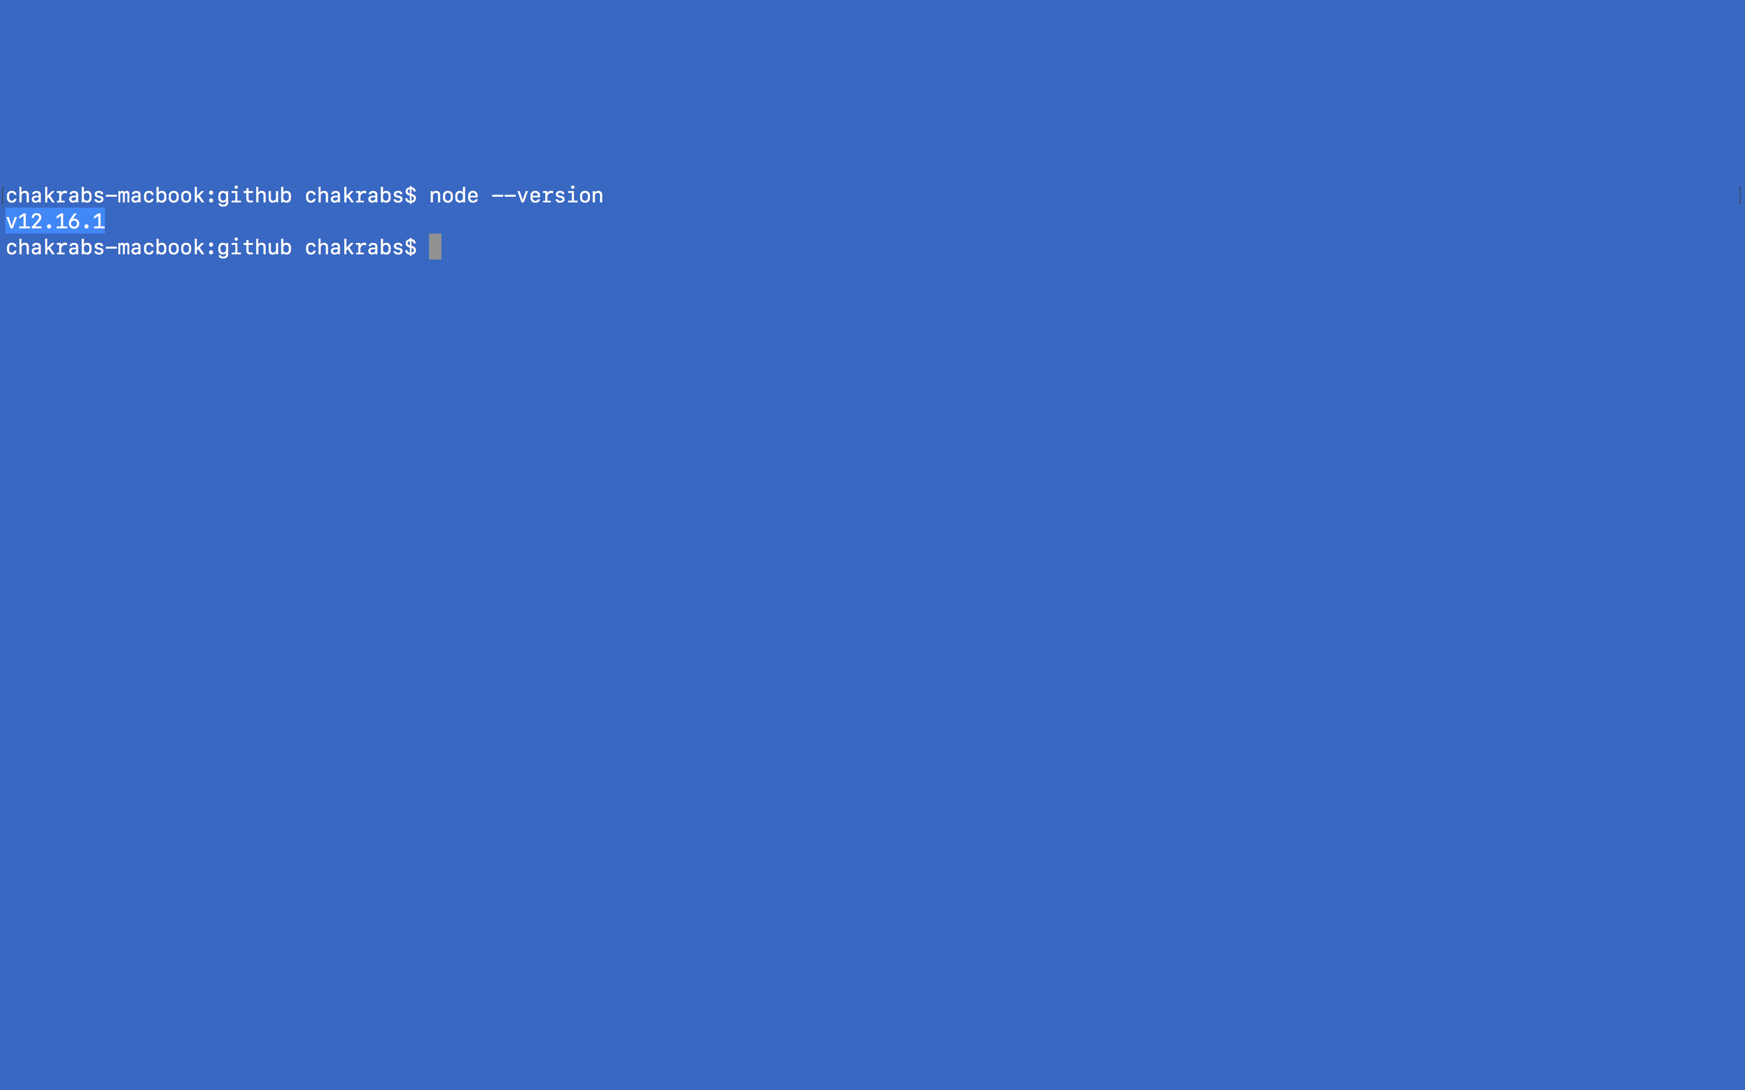
nojeJs – cont.
After you do so, type the following command in the terminal/command prompt:
node --version
It will show the version of node that you installed.

Slide 6
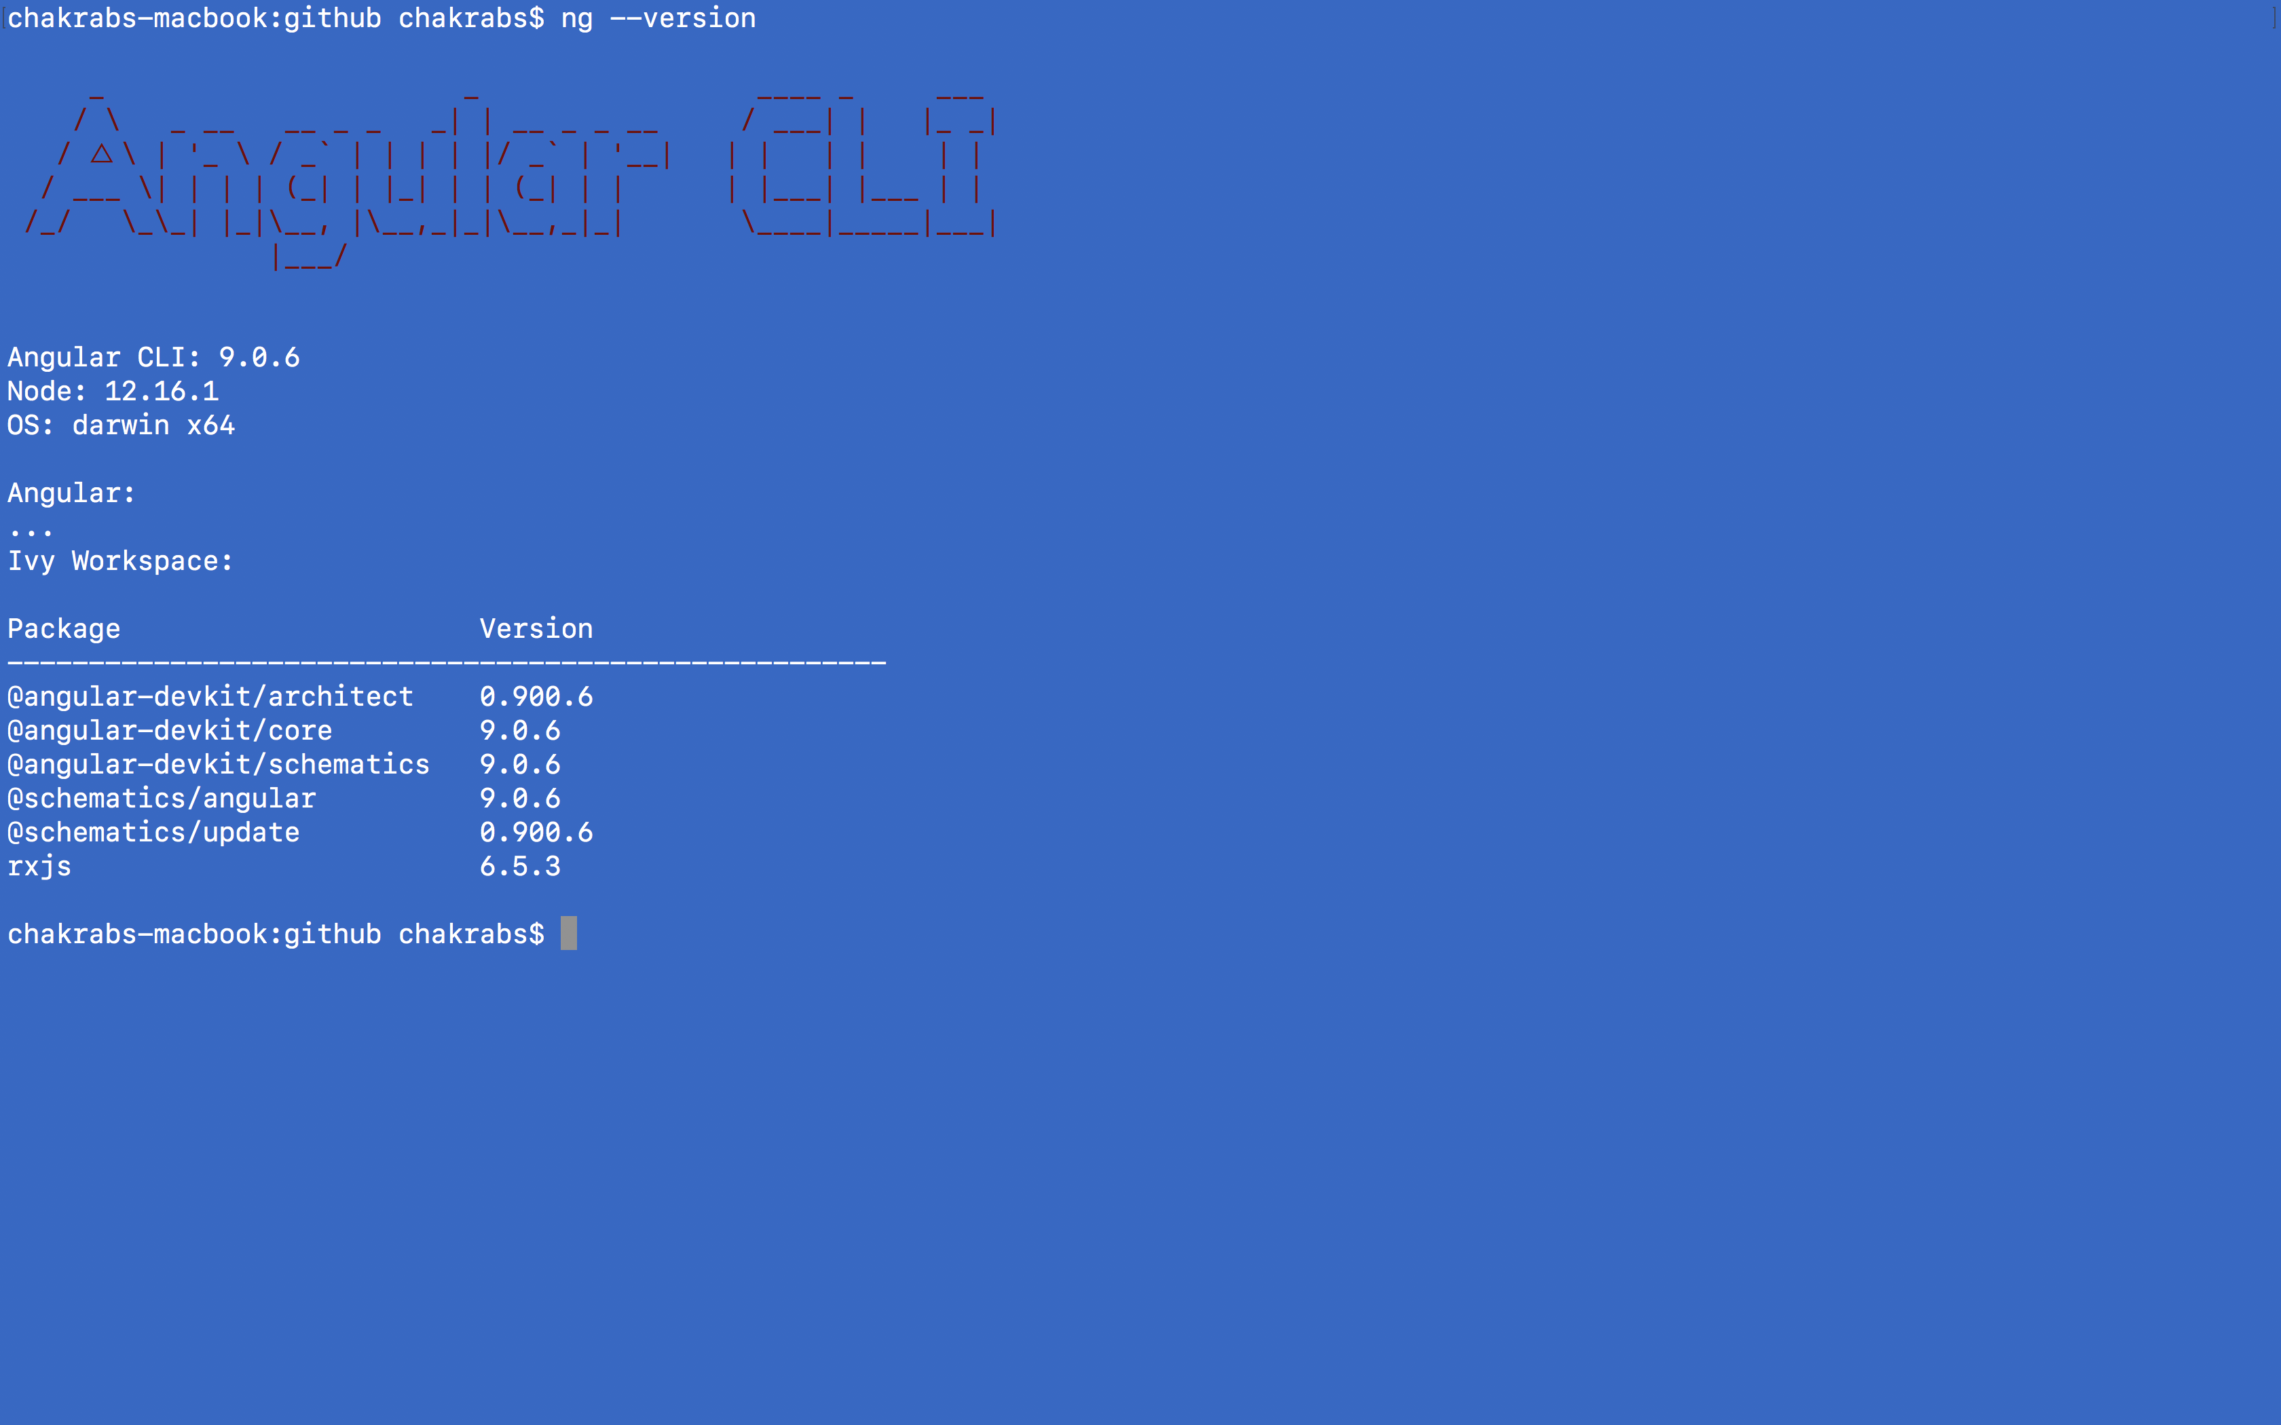
Node Package Manager (NPM)
NPM is required to install third party libraries
We will install the library angular-cli.
angular-cli is used to create new angular projects, deployable packages etc.
Execute in the command line:
npm install –g @angular/cli
In mac: sudo npm install –g @angular/cli (‘g’ stands for global)
This will install angular-cli in your machine.
To verify that the installation was successful, enter:
ng --version

Slide 7
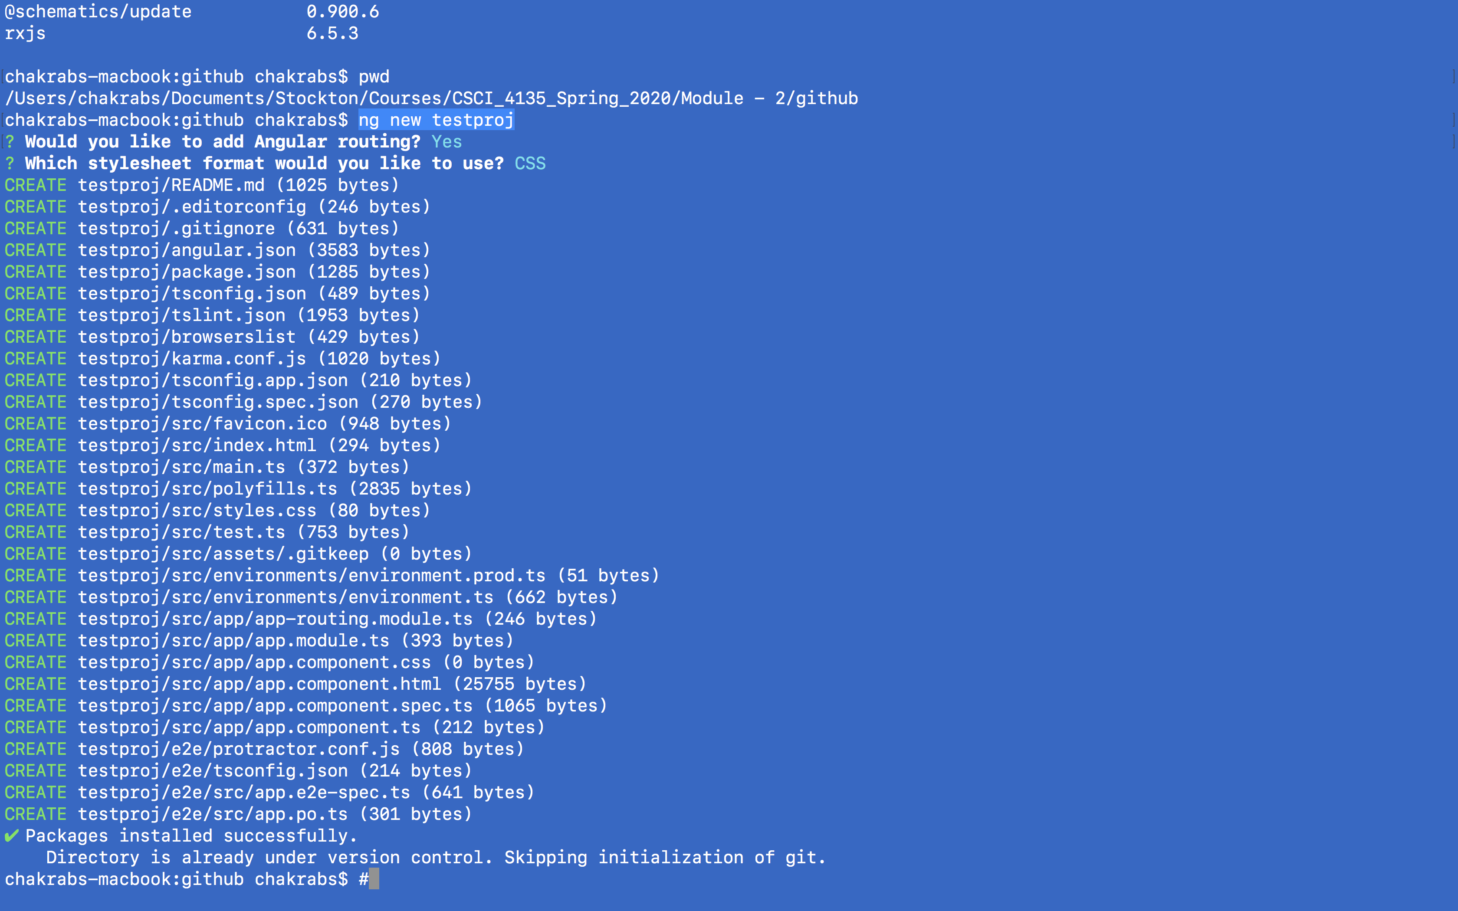
Creating a new project
Issue the following command on the terminal/command prompt:
ng new <project-name>
It would create a project directory with all the required structure (automatically downloads third party libraries via npm).

Slide 8
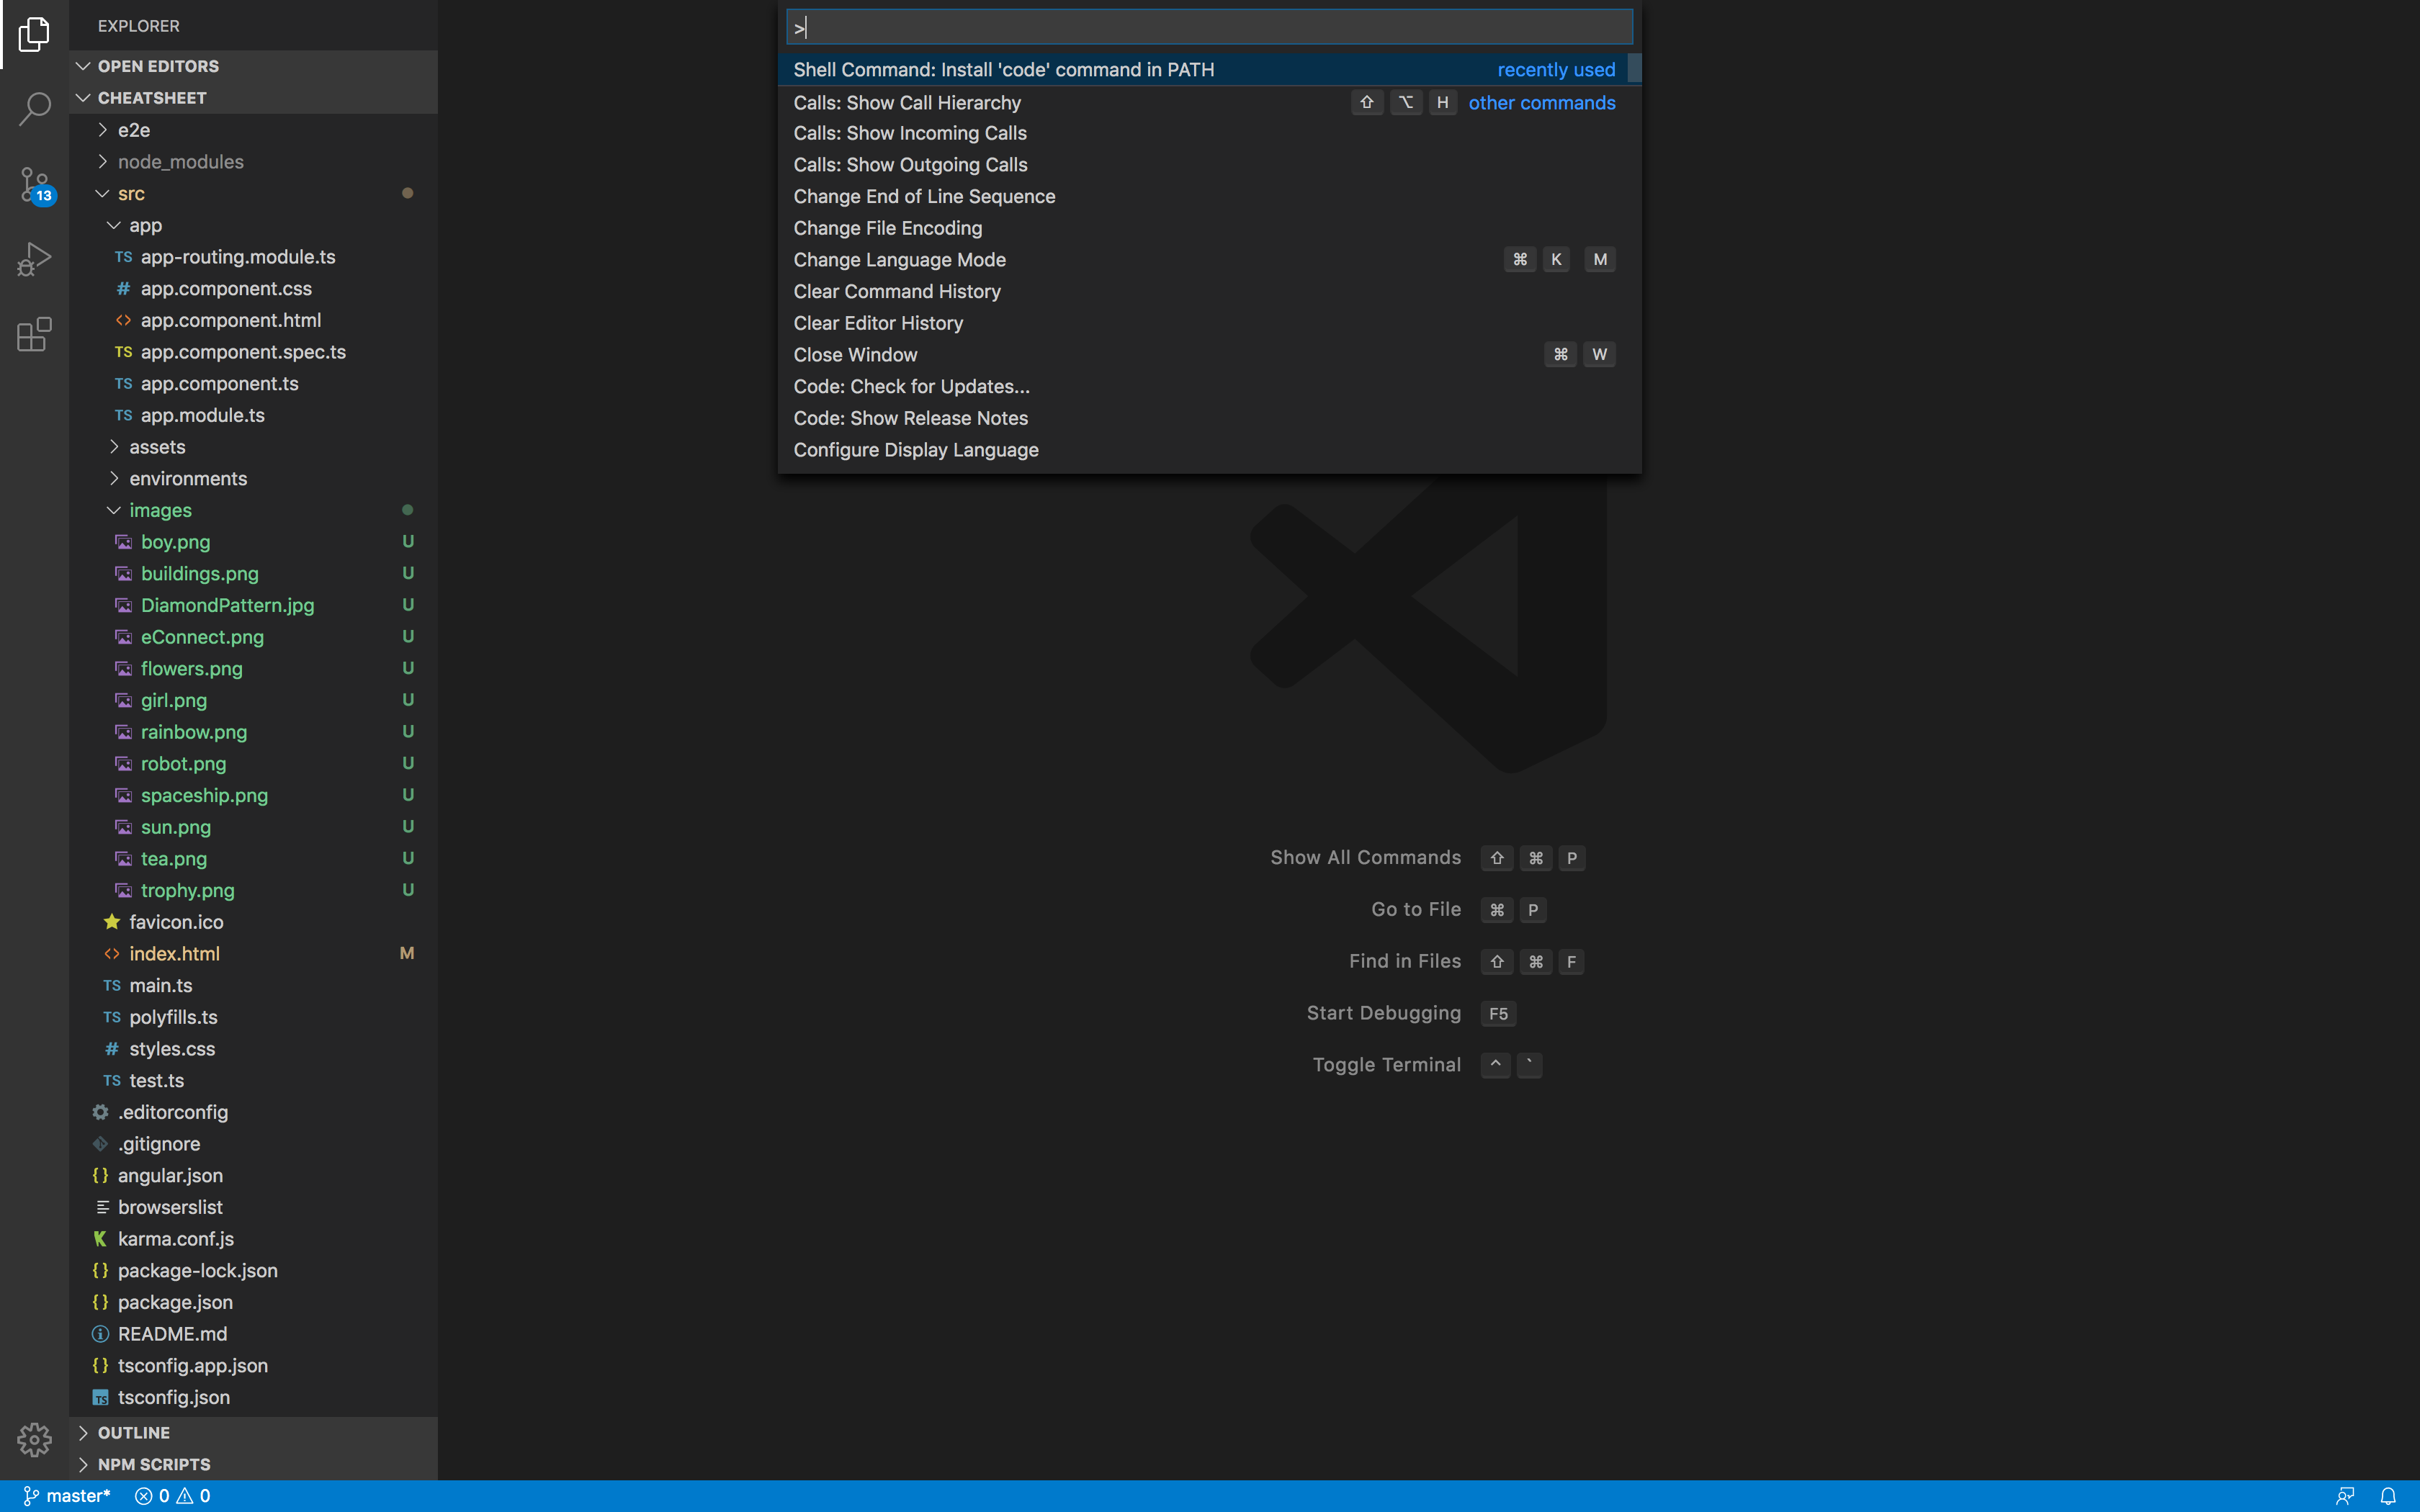
Installing VsCode
To start coding, we’d need an editor.
You can use any editor of your choice (Atom, sublime etc.).
We will use Vscode. You can download it from https://code.visualstudio.com/
Once you download and install it, please add it to the path (refer to the screenshot here).
Press shift + command + p (Mac)/Shift + ctrl + P (Windows) and add it to the PATH.

